Slide 1
11 Webinars For Distributor: Mgt. Teams; Trade; and Buying Groups*
Embracing New Paradigm Thinking (2 -20; 18 slides )
Amazon Business Effects (22 – 39; 17 slides )
Net-Profit Analytics Basics (41– 59; 18 slides)
Net-Profit-Analytics Plays – I (61 – 82; 21 slides)
Net-Profit Analytics Plays - II (84 – 103; 19 slides)
Net-Profit Analytics Plays – III (105 -120; 15 slides)
Net-Profit Analytics Plays – IV (122 – 137; 15 slides)
Migrating to New Selling Models for 2023 (139 -155; 16 slides)
Adapting Past, Selling-Model Shifts ( 157 – 178; 21 slides)
Cracking Target, Whale Accounts (180 – 197; 17 slides)
Managing Change; Getting to a Data-Driven Culture (199 – 220; 21 slides)
* All parties are welcome
to cherry-pick the slides
to create a customized webinar

Slide 2
(#1) Embracing New Paradigm Thinking
Embracing New – Business, Channel and Selling – Models for
On-Racing, Cloud Ecommerce
2. Why Order-size and Line-Item Profit Equations are Key Enablers?
Uses?
Human biases minimize the challenges and possibilities at hand
A Cloud Ecommerce shift is here. Rethink necessary, big changes going forward.
Paradigm changes have happened before. We can do this one. A call to action!
D. Bruce Merrifield, Jr.
www.merrifieldact2.com
bruce@merrifield.com
Connect at LinkedIn

Slide 3
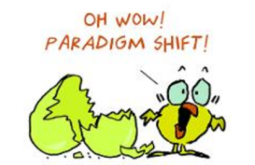
What is a “Paradigm Shift”?
Heaven’s Center ➔ 3rd rock from the sun (1513 to 1650)
Darwin/Apes. Slaves to 1861; civil rights ‘64. Women’s vote: 131 yrs.
Personal selling to:
3PL-type (math!) for flex. E-Selling options for….
Cloud Ecommerce ‘23? (Push to pull marketing. Empowered end-users)
Stages of acceptance:
Ignore. Don’t Listen. Incented to not get it
Get it; laugh, mock
Fight you (esp. well entrenched): burn him at the stake. Fear >> Gain?
In the All-Win Future: I was for it!
Choose: Sell; Harvest; Deny/Ignore; or Renew & Reinvent?

Slide 4
Confirmation-Bias Blinds Us to Paradigms?
Sub-Topics
Amazon biggest, accelerating(?) inventor of Cloud Ecommerce
Asian clones + Millennial B2B buyers + webrooming = commodity hell
Digital Technologies life-cycles are accelerating
New tech tools x 5G Bandwidth ➔ Configurators + Curated e-videos
We don’t think exponentially. Look for 1 cause for 1 effect.
Incremental Forecasting v. Future, Customer Back-Casting
Is fine-tuning the Status Quo riskier than Re-inventing Business Models?

Slide 5
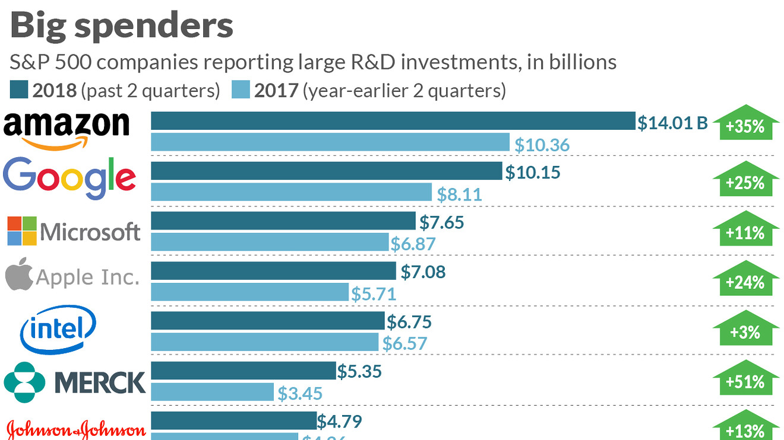
(AMZ’s is all aimed at owning Primes’ First (Voice) Searches for Everything)

Slide 6
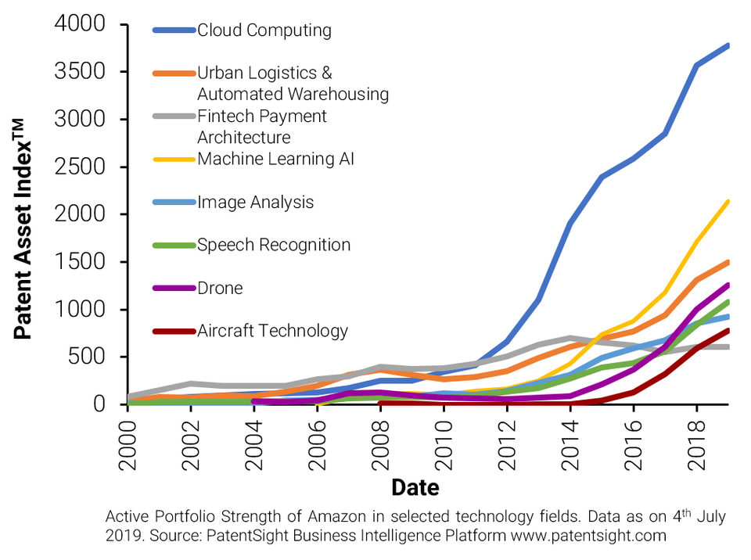
AMZ’s Patents Focused on Every Step of End-2-End, Value-Channel x THE CLOUD
CONNECT THESE B2B DOTS:
CIA (all governments)
MRO procurement for Giants.
Central Spend Management Tools
3. Asian clones: dynamic shelf-space
B2B brands need “digital-content, engagement strategy for end-users
All “disruptors” use AWS “microservice” tools. Will You too?

Slide 7
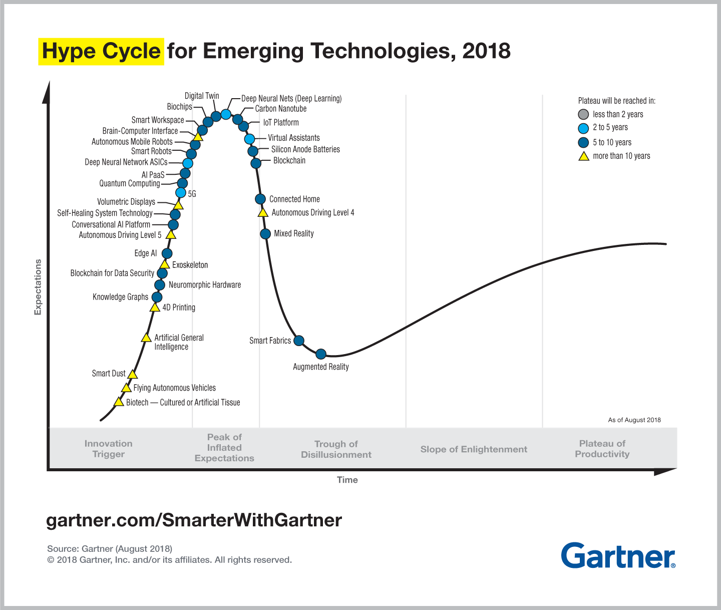
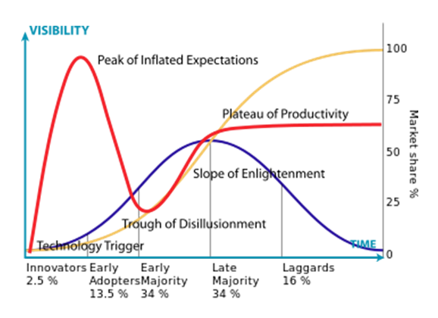
Adoption Curve yields S-Curve sales growth.
Foresight tool for Cloud-Ecommerce possibilities?
(P.S. AMZN invests top-down with 3-10 year horizon. Turns wins into AWS microservices for disruptors)

Slide 8
Bottom-Up: Army of 2-Pizza Teams
2-6-page plans to get funding
Teams expose data, functionality via APIs
Only communication via these interfaces
Network. Borrow. Steal teammates. Overlap is OK, best will win.
No exceptions. Do it or be fired.
Interfaces designed to be platformed to outside world
Microservices flow into AWS Cloud services
Invent new KPIs with Prime Retention overall. And, use AI!
For Every Step, Service along Cloud Value-channel. Piranha frenzy.
What AMZ-BIZ, nibble-to-chomp work-arounds are they inventing?

Slide 9
AMZ AI History, especially concerning
‘99: AI beats humans at book recommendations/selling
Every 6-page innovation pitch includes “use of AI”
“Hands-off-the-wheel” replenishment to doorstep
Real-time clickstream auto orders and distributes replenishments
No people, paper; less inventory, higher fill rates, real-time tracking
40% of sales from AI selling. (fresh produce: 50% to 95%++)
4-9-15: Introduced “AWS Machine Learning” + data + computing?
Clickstream growth + Gravitron2 chip (12/19) + 40% cost/speed
Translations, voice (Alexa) 100% better in past two years
Trusted Voice Commerce by 2023!
Compounding Vigorish Factors Yield Surprising Upside, Flywheel Results

Slide 10
“End2End, Real-time-AI, Cloud, “Value-Channel”.
General AI News:
Algorithms beat: Go, 5 opponents in no-limit, hold’em; Radiologists
AI’s silent touch is everywhere on the net
Configure-Price-Quote (CPQ) trend? Ease, Speed, virtual e-help wins.
Threat of AMZ’s “exclusive brands”
Asian Clones of your cream SKUs. Dynamically appear for webrooming.
No people, paper. Dynamic replenishment: Less inventory, higher fill-rates.
Big Brands must be there (at least as for marketing awareness)
And, AMZ-BIZ’s MRO spend cloud tools! 0 to 20% share – fast!
Product-pushing, pipe channels response?

Slide 11
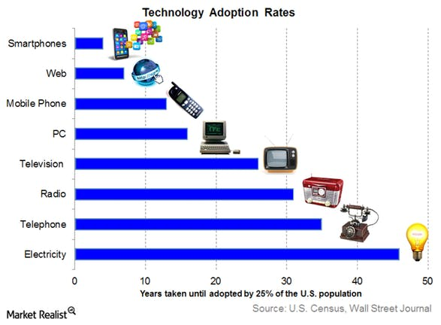
Adoption Rates are Accelerating. Digital Natives Fast Adopters.
Pokemon Go had:
50MM downloads in 19 days
500MM in 6 months
What converging trends will be game-changers by 2023?

Slide 12
Key Converging Trends
Elastic Cloud Computing. ’11 -“no way”➔ ’19 - “cloud-first”!
Big Data/Clickstreams (+) Machine/Deep Learning(AI/Bots) + Chips
Smartphone (clickstream) goes to Best, Dominate Platforms. E.g.
Social Media (Facebook, Instagram, Twitter)
Content: Google, Apple News; Netflix
AMZN for stuff. Uncatchable, irreproducible: Prime, MktPlace, AWS, etc.
Internet of Things ($1 chips@cloud edge; Echo/Alexa in smart all)
Accelerators: next-gen B2B buyers; 5G; Voice Commerce
Explosion of info-videos and CPQ* tools ➔ Virtual e-selling scenarios
*Configure – Price – Quote (CPQ) software solutions

Slide 13
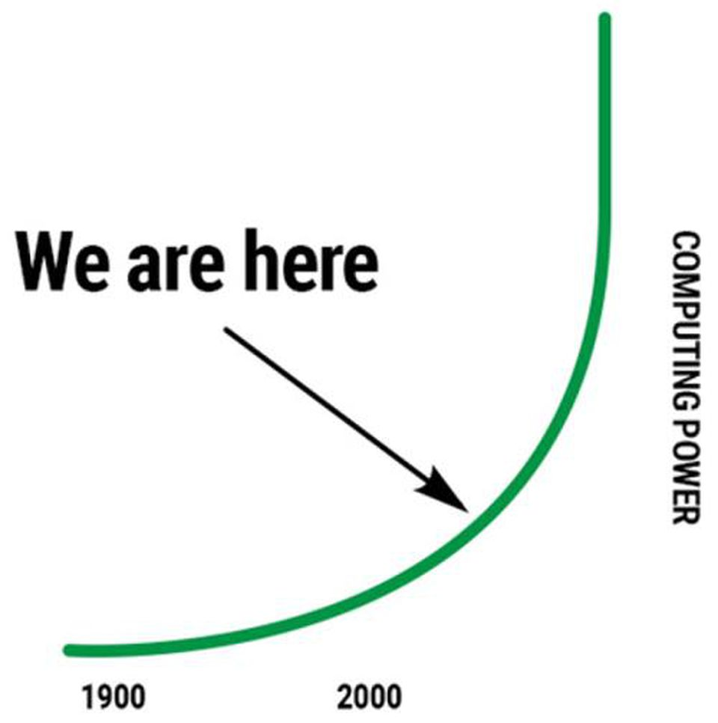
We Think: Linear; Now; and See 1+ Cause(s)/Effect
Amazon invests 3-10 years out x Exponentiality (+) AI

Slide 14
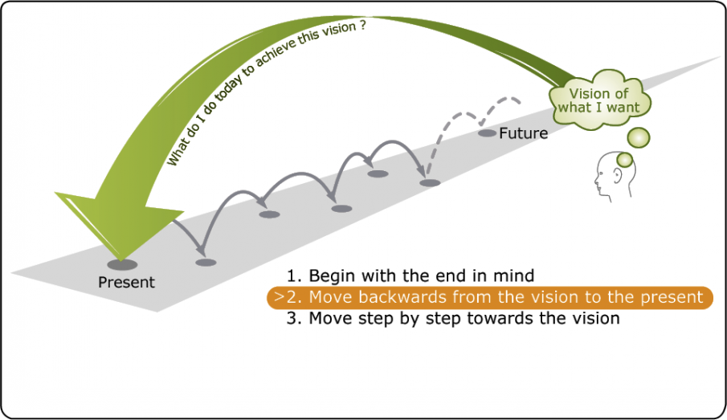
Can We Back-Cast to Innovate Forward?
Open-minded to: New Paradigms? Vocabulary, concepts?
Forecasting v Back-casting
Back-Cast to evolve Best, Right Questions to Live Into.
Answers emerge. Then, experiment; fail/learn forward
Typical Forecasting?
Incremental improvements
Fine-tuning what has been
Fine if no/low external changes
Great White Shark ➔ Gator
400MM years of evolving
New model for the swamp?

Slide 15
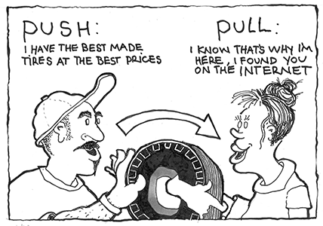
Future Perfect Thinking on: Push to Pull
Customer Product (Discovery, Educational) Journey
Digital, crowd-sourced, pull, JIT for 600MM+ SKUs……..
55%+ of searches start at AMZ. 90% check before buying elsewhere
AMZ App # 1 for millennials who: avoid reps; webroom shamelessly
(Video) Content Management wars by Brands. New channel-models?
(v.) Cost-benefit of reps pushing only your SKUs
Existing service-bundle-cost model can’t meet
the disruptor prices for cream-SKUs! (?)
Two (?) years to install new e-selling model(s)

Slide 16
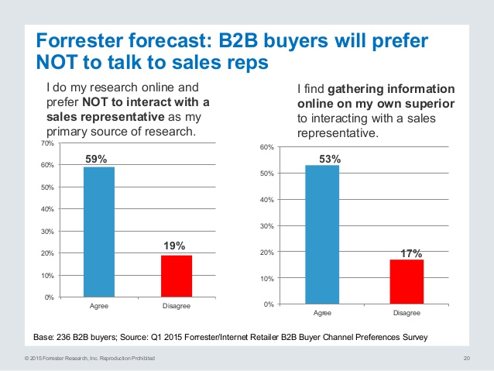
Rep Avoidance: Growing trend since Q1 of 2015?

Slide 17
Discuss “Best Practices”; and, What Don’t We Know?
Better (herd) Practices/Opinions?
@ Association or Buying Group Meet’g
Growing Unknowns: Cloud Commerce

Slide 18
“Digital Transformation” Questions
We love B2C buying, but our B2B customers want Old-School(?)
Car dealers. In ’99: 40% of profits from new cars. Now 0 to 10%.
Showrooming; stripped, shopped. Now B2B Web-rooming/Rev. Auctions
Get FAQ answers on-line. Will Reps be able to e-answer deeper questions!
Configure, Price, Quote (CPQ) auto experiments in Europe.
Easy, fast, less-cost quoting v Traditional process?
Sell, make, ship direct (+) re-intermediate cooperative distributors?
Cost-to-do math for rebalancing the give/gets for innovative solutions?
Best innovators expand, capture and share value

Slide 19
Questions to Live Into/Discuss (2)
3. Search AMZ for your brands v. competitors? (Quarterly trend?)
If 50%++ of searches begin at AMZ and
Clones buy brands’ name/SKUs for searches, they win by default!
4. So: AMZ Brand Registry = “marketing channel”
Ripple effects on rest of e-buying journey scenarios?
Embrace both dis and re-intermediation possibilities. Not All or Nothing.
Will AMZ become a less predatory seller?
Got critical-mass liquidity/volume for their platforms. Now get 3PL fees
Show government they are arms-length, profitable on own brands
AMZ criticisms: more 2-Pizza-Team innovation opportunities

Slide 20
Questions (3)
6. Need for both customer and SKU net-profit analytics to (web 3-7)
Reduce cross-subsidies
Rebalance duties and give/gets with Big Suppliers.
Go to customer-centric, flex-rep model and incentives
3PL math to partner best customers:
For repeat-buy, commodity goods.
Unbundled fees for a la carte services including new/evolving needs.
Evolving, ever-green, win-win replenishment solutions (like McDonald’s)
Especially profitable Gazelles (3% perpetual innovators; fast growth)
Weed to feed, prune to grow works for customer vine/bush too!
Hope you will join me for some or all of the 11 webinars in this series!

