Slide 1
11 Webinars For Distributor: Mgt. Teams; Trade; and Buying Groups*
Embracing New Paradigm Thinking (2 -20; 18 slides )
Amazon Business Effects (22 – 39; 17 slides )
Net-Profit Analytics Basics (41– 59; 18 slides)
Net-Profit-Analytics Plays – I (61 – 82; 21 slides)
Net-Profit Analytics Plays - II (84 – 103; 19 slides)
Net-Profit Analytics Plays – III (105 -120; 15 slides)
Net-Profit Analytics Plays – IV (122 – 137; 15 slides)
Migrating to New Selling Models for 2023 (139 -155; 16 slides)
Adapting Past, Selling-Model Shifts ( 157 – 178; 21 slides)
Cracking Target, Whale Accounts (180 – 197; 17 slides)
Managing Change; Getting to a Data-Driven Culture (199 – 220; 21 slides)
* All parties are welcome
to cherry-pick the slides
to create a customized webinar

Slide 2
Specific Net-Profit Analytical Plays in Webinars 4-7
Webinar #4:
How GM$s/FTEE is a 4-win metric
CEO takes #1 account to next level
Fixing 3 types of losing customers
Beef best SKUs; Fix Losing Ones
Big Rebate Suppliers: New Angles
Webinar #5:
6. High Credit Activity Expense Customers
7. Customer-Niche, Service Excellence Innovation/Domination
Better, High-Yield Quoting Niches and Generally
Webinar #6:
9.Reducing Repetitive Inter-Branch SKU Activity
10 a-c: Solving (Branch) Counter Sales Unprofitability
Webinar #7:
11-a. Biggest Loser Analysis/Solution
11-b. Worst, small loser: analysis/solution
11-c. JIT Delivery of Paper Clips: Solution

Slide 3
(#3)Net-Profit-Analytics Basics
Analytical Lenses To Cure Financial-Management, Blind Spots
Whale Curves; Root Causes of Customer Profitability/Loss
Uses?
Without a cost-to-serve model distributors accumulate losing activities and lack the insights to fix them.
The busy-ness from losing customers distracts from doing more for best, net-profitable accounts.
Those incented on sales and margin dollar volume will fight new insight plays even though the upside gains would benefit them (and all). Education is the cure.
D. Bruce Merrifield, Jr.
www.merrifieldact2.com
bruce@merrifield.com
Connect at LinkedIn
Request this slide deck ➔

Slide 4
Warm Up for Net-Profit Mechanics
New Perspectives (Lenses) spark what reactions?
Who knew? What don’t we know? Unknown, unknowns?
Or: embarrassing! Keep the status quo! Follow the herd!
But, all stakeholders want more (raises?)
And, disruption is the new normal
Isn’t innovation the only choice (?)
How to Comfort Zone a New Paradigm’s statistical, math reality?
OK, be open to “net-profitability analytics 101” (NPA)

Slide 5
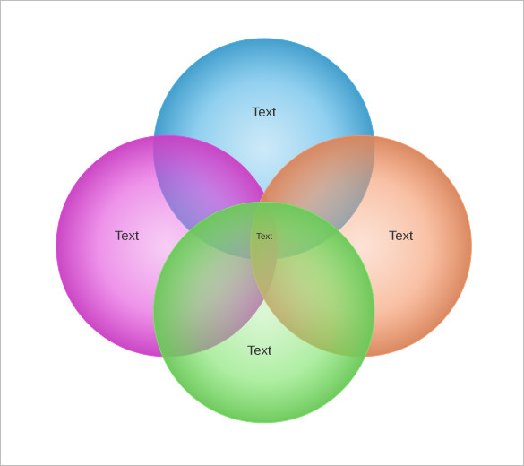
1) Financial Lens:
Dominant. Win-Lose mantras.
Blind to: order-size and Cost-to-Serve/order; “Profit Equation”
2) Order-Size Economics’ Insights:
Create/Sell win-win, average-order-size relationships.
Target best customers for Service-Value Innovation
Earn: Last-look + 2 points. Or, pivot into a win-win partnership system
Fix losing accounts: big and small
Grow - sales, profits and rebates – as byproducts of targeted customer value solutions
3) Customer/Niche Service Metrics:
Universals: fill rates; zero errors; on-time-delivery. Response times and Niche-specific needs vary
Key Service-Execution Capabilities:
Best customer niche metrics: yield 4-Wins; Need a high-performance, Service Culture
1) Financial
2) Order-Size Math; Customer Profit Analysis
4) Key Execution
Capabilities
(web #11)
⬅ Own➔
3) Customer (niche)
Service Metrics
(web #5)

Slide 6
Comfort-Zone “Order-Size Economics”
Peels of the Onion: My first – “turnaround, renewal”
Curiosity/Observations: 30% deliveries to Mom/Pops, small-orders
Death by a thousand cuts?
Opportunity cost? Heroic extra efforts for most net-profitable?
Distribution a process, crank-turn-costs/day v The GM$s per crank
First bearings: annual averages per TRX for (both direct and warehouse)
Sales/Trx. GM$s/Trx (less) Op Expense $s/Trx (equals) Profit $s/Trx
Looked at GM$s/invoice out of warehouse to be delivered. Shocked! “62%” unprofitable?
How many customers give us only (many) losing orders?
Do “Scientific Method’! Observe, Questions, Invent measuring tools, theories (repeat)
What received-wisdom assumptions (and lack of curiosity/greed) prevents this?

Slide 7
Comfort-Zoning (2)
4. Did a crude ranking report (rapid prototyping 1.0)
GP$s (12 mos.) less (TRXs x Avg Cost/Trx) = Approx Op. Profit
Very top and bottom customers are winners and losers for sure!
Bottoms were not minnows; but, “good GM$ accounts”. 5-Why analysis?
The pushback objections were quick and dismissive
http://merrifieldact2.com/e-book/chapter-five/1-39-objections/ (Forgive!)
“Model’s not perfect! (keep status quo)”. Guidelines:
Optimal complexity, maintenance; Extremes jostle, but don’t change.
Not an audit gotcha-game. A strategic, decision-tool advantage.
SKU/Pick level: 1) Sub-groups of Big Losers; 2) Friction within all accounts

Slide 8
Comfort-Zoning (3)
Raises? Then, grow GP$s/head by 20%. Two scenarios:
20% more average activity. Must add folks
Every – customer, line, order- magically increases GP$s by 20%
Economies of order-size v. Total-sales economies to more customers
Action steps:
Freeze head count.
Win new big-order customer flow (Team focus on: “5-5-5 accounts”*)
Too busy! Plays to consolidate small-GP$: picks, orders and customers.
Big, accumulated minnow problem.
Nice Trade: Give retail-sized orders, Get wholesale services(costs), prices
New terms: 1) Gradually (prune to grow effects); or, 2) Extreme + layoffs
*5-5-5 Kit: http://merrifieldact2.com/wp-content/uploads/2014/11/44-Ex44555kit.pdf

Slide 9
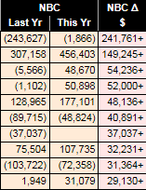
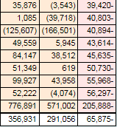
Comfort Zoning “Prune to Grow”?
Fixed FTEEs already dynamically redeploying!
Top 10
Bottom 9
Sell All, Get GDP growth
But, hidden volatility
Lost activity ➔ Won. Weed to feed exists!
Big Ups, Downs?
Next year lessons?
5-5-5 Inputs
Make your luck
NBC = Net Before Comp
(less) incentive pay = Op. Profit

Slide 10
Net-Profitability Mechanics: Terms, Concepts
Profit Equation (PE) Management:
GP$s – CTS$s = Profit $s (no GM%!)
Year-end P&L is (macro PE) the sum of all (micro) line-item PEs
Whale Curves:
Learn, experiment at the extremes
Root Causes of customer profitability/losses.
Law of Reciprocal costs with Big Losers
Rebalance Service Energies: triage and heroic acts
Economies of GP$s per Transaction. Profit flow-through!
Distributor costs can’t win (v AMZ) on small-$ picks and orders

Slide 11
Pyramid of Profit Equations (PEs) GM-$s (less) CTS-$s (equals) Profit-$s
Year End P&L = Macro PE: e.g. GM$s (randomly 25%) – CTS$s (22%) = P$s (3%)
3 Service Model PEs
10 Rep Territory PEs
30 Product Group PEs
15 Customer Niche PEs
300 Supplier PEs
1,000 Customer PEs
20,000 Order PEs
5,000 SKU PEs
50,000 Line-Item Micro PEs
(with GM%s from negative to 80%)
Quantum Profit Data (QPD):
Smallest indivisible unit of profit or loss Micro PEs add to higher-level, Mini PEs

Slide 12
Profit Equation Discoveries (1)
Average GM$s/Invoice correlates with Op. Profitability
Accounts, SKUs with high GM% averages are often losers
For Big – picks/orders: the GM% drops less than order size scales
Lots more GM$s in the pick/order >> CTS$s for the order = Profit$s
Do be pricing efficient.
But, “Buy-low, Sell-High”? Zero-sum; mistrust game; 50 years of trying?
GM% myopia is universal within channels, so:
Direct Shipment P&L is typically very profitable
Counter business is typically very unprofitable
Benchmark counter’s CTS structure and terms v. Home Depot, Fastenal, Amazon

Slide 13
Profit Equation Discoveries (2)
Losing-Element Statistics (innumeracy challenges?):
70% of lines
62% orders
30-60% customers
20-50% territories
Vendors: a few big winners and losers (bits and pieces with high GM%)
5% of warehouse SKUs big winners v. 5% are big losers (hi-pick, small-$)
2-Step, counter-business loses at 35% less (FAST 57%+)
But, initially do “affirmative inquiry” or the “Bright Spots” Better

Slide 14
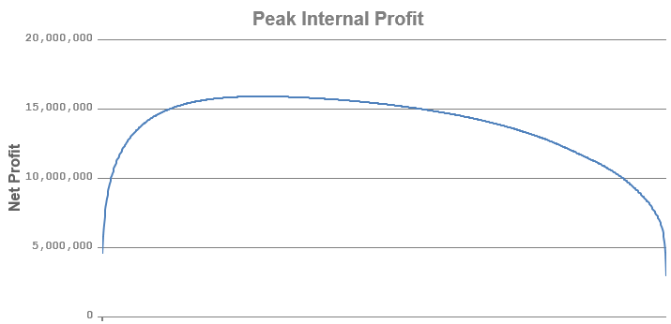
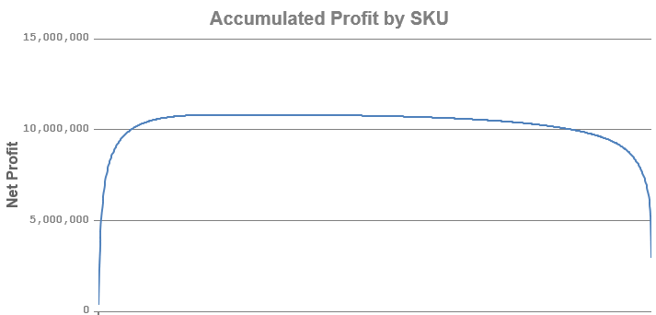
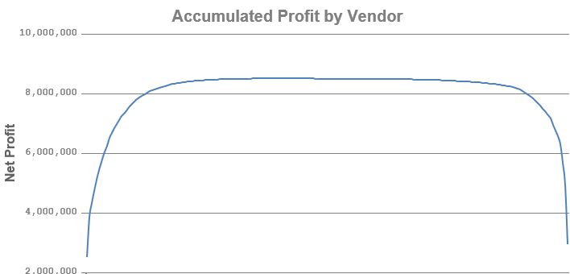
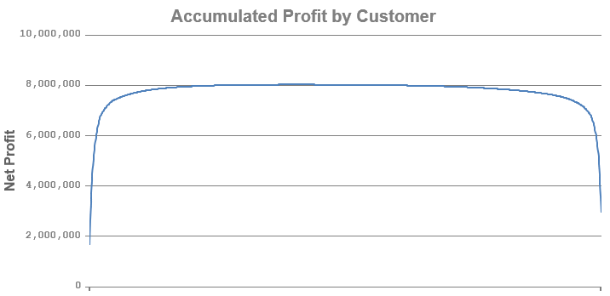
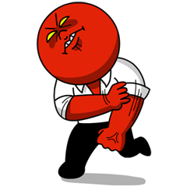
Different Whale Curves (client Z)
Dig Deep at Extremes to Find
High-Leverage, Low Risk Insights
PIP:$15.5MM
PIP: 10.5MM
Every Line Item P/L plotted
SKUs’ P/L Plotted
(LEAST ACTIONABLE)
PIP: 8.5MM
PIP: 8MM
Every Vendor’s
P or L Plotted
Customer WC
MOST ACTIONABLE
Intersection, cream-buys
lost Initially to AMZ: 2/20+ Hit to Profits
Every curve has all line-item profit equations included.
Why different PIP’s and same Tail-end profit total?

Slide 15
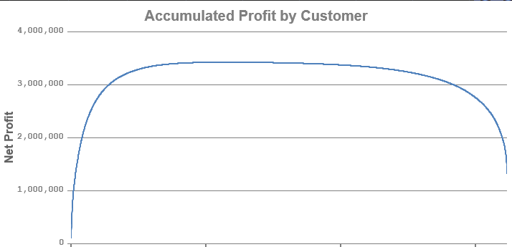
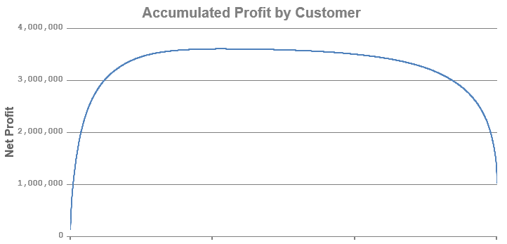
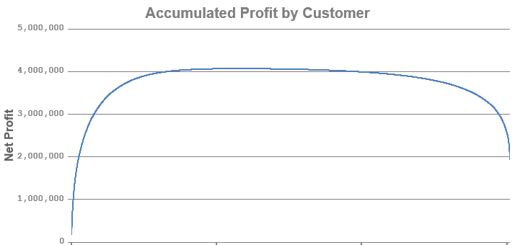
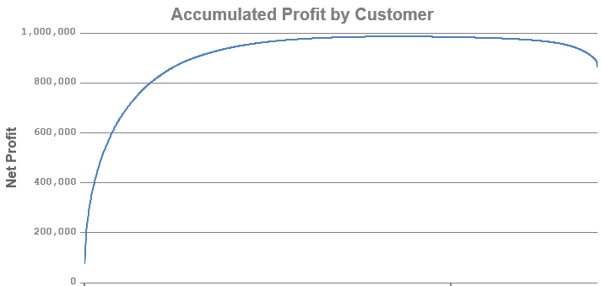
Customer Whale-Curve Strategies: Head/Tail Accounts’ Habits Persist
2014
2016
Example of near-perfect
Customer Whale Curve
2015

Slide 16
(Breathe at #2) Next-Question/Path? 10-Step Journey and Beyond
Cost-modeling for Line Item profit/losses
Customer (etc.) profit rankings ➔
Tools for Root Causes for Profitability (GM$/line)
Root Causes ➔ New “Aha!” Insights (reciprocal costs!)
Insights lead to New-Play experiments
New-Play execution requires New Skills
New plays➔ New Incentives based on Profit Equations $s
Plays/incentives require New Tracking Reports
Scary? Baby-Step Experiments to start? (1 customer?)
Combined experiments add to New Visions (Questions)

Slide 17
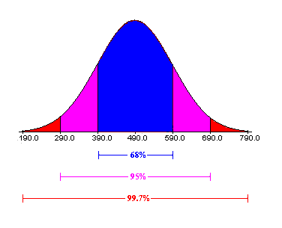
Win Big Streams of Profitable Orders. Best v. Worst Customers
Most Profitable Customers. Big and..
Most Unprofitable? (Tolstoy)
De facto Partnered your team
Disciplined Rebuy System:
System metrics >> Silo metrics
Pursue Total Procurement Cost (TPC)
Extra Inventory ➔ Uptime Productivity
And, better Customer Retention
To grow faster, more profitably !
Regression happens when key personnel turnover. Prepare for it.
One contract + decentralized, dumb or cherry-picking buyers
Cherry-Picking by competitors’ Bigs
You are third+ in line for oddities
Apply JIT, Zero-Inventory to popular, small-dollar items.
Ignore high rebuy activity costs
Good order, but many small picks
Custom spice rack solutions.
Learn Best Practices from Winners to then sell and install at the Big Losers

Slide 18
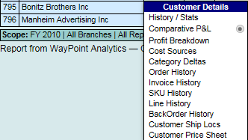
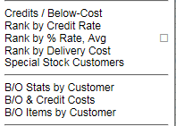
Win-Win Activity Consolidation? Deep-Dive with 15 Lenses
For every customer Right Click for 11 Lenses
Skim through to spark:
New, targeted questions
Local team has Aha’s!
1. Find Macro (habitual and Odd) Activities
2. Big-Losers’ Cooperation Continuum:
Friendly: what can I do
Don’t care about you, but me?!
Cherry-Pickers (“big potential”: not)
Don’t care, won’t budge.
Under Customer Tab. Customers Ranked by:

Slide 19
Re-Balance Service Energies!
From: All Get “Good” Service
To: Net-Present-Profit Value (vocab!)
React to Every request
Democratic: first come, first serve.
Same service, speed. Stop at 5pm
Socialistic: cross-subsidies
Field Reps (time & territory drill):
More accounts, reactive calls good
Call (occasionally) on small fry in between bigger accounts
Dynamic Service Triage
Heroic, Extra-Effort Acts
3-4 Service Models to pursue: 100% customers profitable,
Best Reps x Best Accounts x Proactive, “10” calls with Team Selling Support (v geographic, travel time, calls/day math)
No Whale Tail. 100% profitable

Slide 20
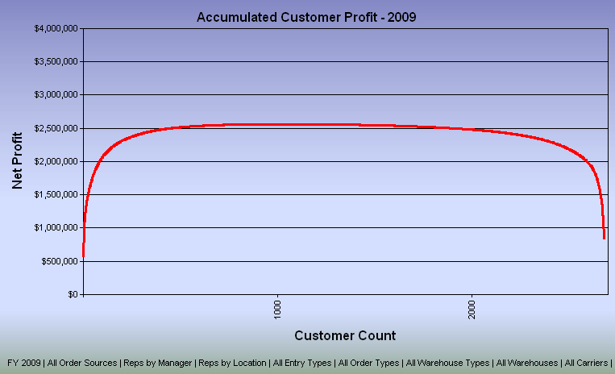
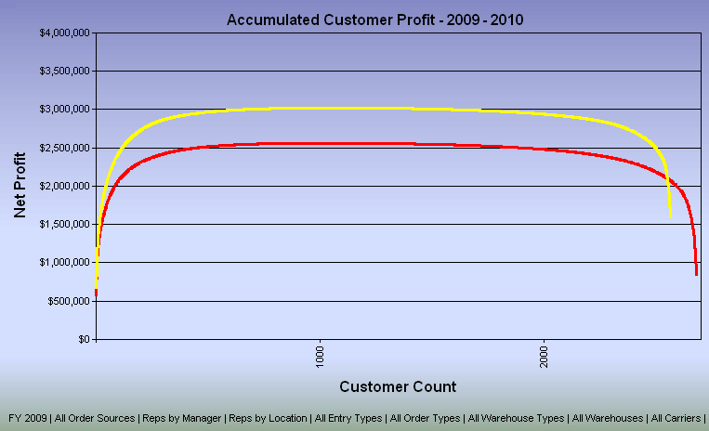
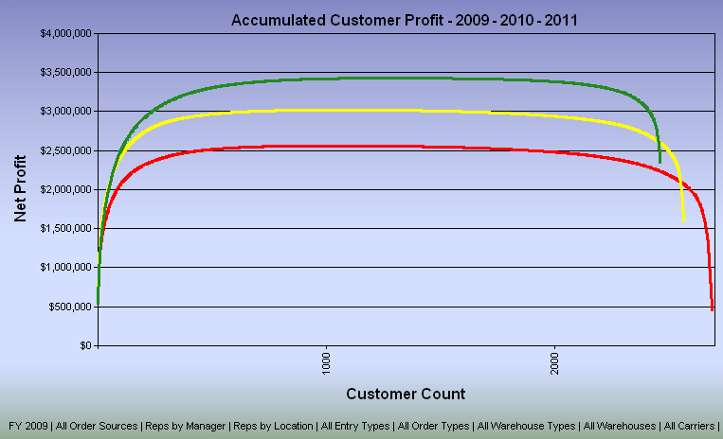
Customer Whale-Curve; New-Play Results over 24 Months
Weed to Feed;
Prune to Grow
Works for: Pumpkin Patch;
Customer Bush!
Re-focus energy to key accounts.
Service Triage & Heroic Acts
GP$s/Head 2X
Profits/Head 15X
4-Win Innovations
1. employees
2. customers
3. suppliers
4. shareholders
1
5) 5X in 2yrs
Bonuses for All
2: many small losers
6) Eventual Goal: “100% of Customers (quickly) Profitable”. No tail to the Whale!
3
4
1) 10% customers ➔ 500% Profits
3) 1% of customers eat 40% of profits

Slide 21
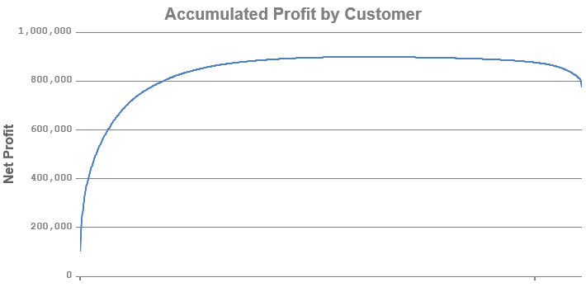
Or, This WPT Client: 30 months to Near-Perfect, Curve. Sales + 75%; Profits up 26X to $76K/FTEE
If 100% of customers are profitable, then 100% of peak internal profits are operating profit and..
A Perfect Whale Curve has no tail!

Slide 22
Egos, Old Beliefs and Incentives Will Resist
All fixed costs: every account/margin dollar is good. No losers!
Big, losing accounts yield big commissions. Reps will revolt.
Read detailed answers to all “objections”*
Chief Experts don’t want to be wrong, and become Chief New-Learners
Bottom 80% of payroll: What’s in it for Me/We?
Is defending the status quo a bigger risk?
Freeze FTEEs; Grow GP$s/FTEE with Bright Spot Plays** Too Busy!!
Then, courage to turn friendly Big Losers into winners+
Small Dollar Accounts (80/20): Solve worst 10, etc.
* http://merrifieldact2.com/e-book/chapter-five/1-39-objections/ + two follow-on links
**“Core Customer Renewal Roadmap”

Slide 23
Summary
Net-Profit Analytics, different: lens, world, vocab, concepts, plays
New: 1) observations, 2) questions, 3) theories, 3) analytics, 4) insights, 5) experiments (scientific method)
Big Insights take Big Changes that spark Big Resistance
Embarrassing? Forgive everyone to move on
High Paid, Veteran Expertise resistance? Protect key incomes.
New plays take new skills. Easier than expected.
Innovation expands juice to feed all who play new game
Opportunity cost of losers? Plus: Cloud ecommerce needs?

