Slide 1
11 Webinars For Distributor: Mgt. Teams; Trade; and Buying Groups*
Embracing New Paradigm Thinking (2 -20; 18 slides )
Amazon Business Effects (22 – 39; 17 slides )
Net-Profit Analytics Basics (41– 59; 18 slides)
Net-Profit-Analytics Plays – I (61 – 82; 21 slides)
Net-Profit Analytics Plays - II (84 – 103; 19 slides)
Net-Profit Analytics Plays – III (105 -120; 15 slides)
Net-Profit Analytics Plays – IV (122 – 137; 15 slides)
Migrating to New Selling Models for 2023 (139 -155; 16 slides)
Adapting Past, Selling-Model Shifts ( 157 – 178; 21 slides)
Cracking Target, Whale Accounts (180 – 197; 17 slides)
Managing Change; Getting to a Data-Driven Culture (199 – 220; 21 slides)
* All parties are welcome
to cherry-pick the slides
to create a customized webinar

Slide 2
Specific Net-Profit Analytical Plays in Webinars 4-7
Webinar #4:
How GM$s/FTEE is a 4-win metric
CEO takes #1 account to next level
Fixing 3 types of losing customers
Beef best SKUs; Fix Losing Ones
Big Rebate Suppliers: New Angles
Webinar #5:
6. High Credit Activity Expense Customers
7. Customer-Niche, Service Excellence Innovation/Domination
Better, High-Yield Quoting Niches and Generally
Webinar #6:
9.Reducing Repetitive Inter-Branch SKU Activity
10 a-c: Solving (Branch) Counter Sales Unprofitability
Webinar #7:
11-a. Biggest Loser Analysis/Solution
11-b. Worst, small loser: analysis/solution
11-c. JIT Delivery of Paper Clips: Solution

Slide 3
(#5) Net-Profit-Analytic Plays – II
Uses? Recipe Plays for:
6. High Credit Activity Expense Customers
7. Customer-Niche, Service Excellence Innovation/Domination
8. Better, High-Yield Quoting Niches and Generally
D. Bruce Merrifield, Jr.
www.merrifieldact2.com
bruce@merrifield.com
Connect at LinkedIn
For webinar(s) slides ➔

Slide 4
Introductory Comments
5th of 10+ webinars on using net-profit analytics to:
Renew profits
Enable new business and channel e-selling models for Cloud Ecommerce ‘23
Previous webinars are all recorded/available
Second webinar on specific how-to “Plays” (first 5 in Web. #4)
Slide decks for each webinar; or, a master for all 11. Email bruce@merrifield.com
Today:
Play #6: High-Systemic, Credit-Return Customers
(Lose-Lose activity costs into Win-Win savings, ex. service)
Play #7: Dominate net-profitable customer niche with service excellence
(Best Service Excellence is prerequisite for partnering best whale/gazelles)
Play #8: Direct-ship, quotation niches to next-level

Slide 5
Play # 6: High, Systematic, Credit-Expense Customers?
(‘74) My first zero-error program: “credits per thousand lines”
Within 6-week pile of credits: a few, big, systematic customers
Ranked customers by credits/transactions. Sub-groups:
15 invoices/15 credits v average of 1%: “shipped me short”! “Rascals”
Dumb work-arounds.
Abusive counter-customer returns.
Game-playing rep
With Line-Item, Profit Equations you can also rank customers by:
Total cost of orders picked, then returned (includes price busts too)
Sold below cost (close-out buyers; samples; etc.)
(Report on Nxt Slide)

Slide 6
Top 8 out of 11,260 Active Accounts
.07% of accounts total 14% of Return Costs ($461K/3.311MM) (Below cost ranking?)
Find alternative solutions to cut the number for top 20 accounts by 50%.
What analyst, process re-engineer will do this? ROI on their salary? Then, their next job?

Slide 7
Credit Cost Cases (returns + below cost)
Type of Distributor Credit Costs as % of Op Profits Operating Profit/Sales
Retail Goods 260% .7%
HVAC (warranties*) 184% 2.9%
Plumbing 112% 2.1%
Physician Supply 55% 2.2%
Electrical/Indust 31% 4.8%
Industrial/MRO 21% 12%
Industrial/OEM 10% 2.9%
Retail Goods 3% 5.7%
* Good with Bad; or: 5-Whys? Customer exceptions? Best v Worst customers? Brainstorm, etc.

Slide 8
Credit Stats for One Chain’s Subsidiaries*
OpCo $s Returns: % of NBC Below Cost: % NBC Total
#1 (37%) (15.5%) 52.5%
#2 (17.4%) (28.7) 46.1
#3 (76%) (43%) 119
#4 (25%) .46 (Negligible) 25
#5 (40%) (21.8%) 61.8
5-why analysis needed at every location to zero in on:
Biggest, dysfunctional customer opportunities
And, best practice locations to share with loose ones.

Slide 9
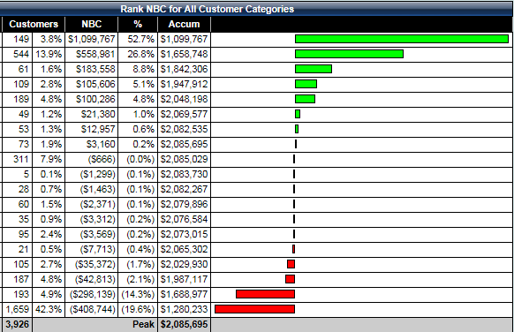
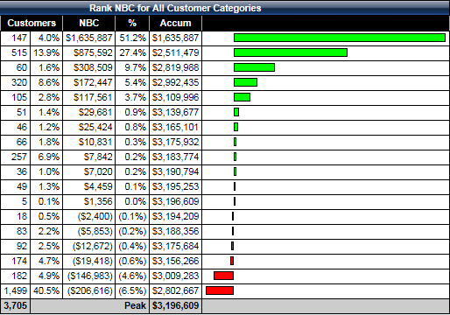
Play #7: Customer-Niche Domination Case
Initial Analysis
One Year Later
Best niche: 3% customers ➔ 50% of PIP; 80% of NBC. Lowest GM%, biggest GP$s/invoice.
2. Fixed losing niches partially ➔ Overall NBC up 1MM in 12 months. #1 niche up 60%
3. 50% Branch Manager buy-in and execution! ?

Slide 10
Nichonomics Recipe (YT Playlist 4: 1- 57*)
Sort top 50-200 accounts into segment piles
#1 historically, most-profitable niche pile?
5 most profitable, progressive accounts in #1 niche? VISIT!
Co-discern next-level Service-Excellence Metrics (+ extras)
Put 5 core and 5 target accounts on wall
Plus metric scoring charts (“big 8”)
Teach: Service Triage and Heroic Extra Efforts via cases
Tie everyone’s – mind, heart, wallet – into “voice of customer”
GP$s/FTEE; Profit$s/FTEE; gainsharing/FTEE - all climb.
* Search at Youtube for: “Bruce Merrifield” + Playlists. Playlist 4’s 57 clips all about Nichonomics

Slide 11
Next-Level Service Steps
Per: Key customer; Niche
(1)
Target
Customer
Niche
(3)
Delay:?
(6)
110% (5)
(2) ?
Us
4
Competitors
(7)
unchanged
(8)
YT 4: 16

Slide 12
Question, Listening Guidelines
YT 4:17
(micro) Past poor service stories? (5-why’s)
Caused: downtime; productivity loss; upset their customers?
Opposite may be a service insight opportunity.*
Make service changes to also help: safety; stress; political favor
Their (macro): buying objectives and plans?
Top few suppliers by percentage of spend: Why? Changes?
If so, why? Future supplier objectives? (McD’s best example)
Be an anthropologist. Ask context, regimen/process Q’s.
In the gaps between process-steps: delays, work-arounds?
Origins of existing: silo metrics, response times, processes.
* Contractors Uptime Ratio = Hours billed/Total Payroll Hours. 50% ➔ 70? Huge!

Slide 13
To Achieve Service Levels?
1. Happy Employees
2. Employee Retention
3. Improving Service
4. Happier Customers
5. Customer Retention
Systems, Praises
6. Growth and Profits
Pay
Hire
HPC
(A)
Mastery
(B)
DIRTFT*
(C)
Sales force
motivation
(High
Performance
Culture)
(D)
Last look
(+)
(E)
(F)
Job
growth
*DIRTFT = do it right the first time
YT 4:30

Slide 14
Service Excellence enables: Last-Look++, or “Partnering process”
Selling products transactionally: 1 of 2-3 suppliers (price-checking!)
SO: Be a pal to old-school buyer. Hope to move to #1 share. Attrition game.
Get last-look. Demand + 2 points for Rep and Service Excellence.
You are best total procurement value at a higher price. OR…..
Quid Pro Quo judo: Turn Win-Lose offer into a Win-Win change.
Lower “hidden” costs for both; boost productivity; afford lower prices?
Retune/rethink order replenishment system.
Move down mutual cost curves continuously, synergistically (McD’s)
“Have my systems team research and offer a proposal?”
More on this in a subsequent webinar.

Slide 15
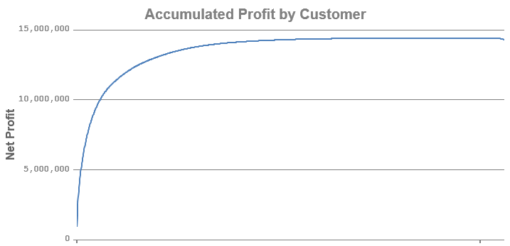
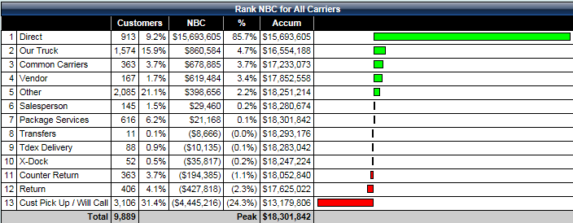
#8: Better Quoting on Directs Electrical Case: Directs v Warehouse
OBSERVATIONS:
Direct is hugely profitable. 5-Whys?
Why is “Pick Up, Will Call” so unprofitable?
Direct Customer Orders
Whale Curve

Slide 16
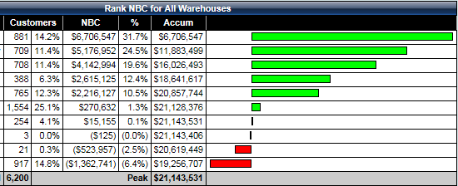
Branch Profits with/without Directs
Lower chart, bottom 5: Wholetail convenience
Must charge for 2: facilities, handlings and inventories. Add 15- 25 points to “list prices” like Fastenal (60-70%). (Webinar #6)
“directs” = Bright Spot! Do quote niches better?

Slide 17
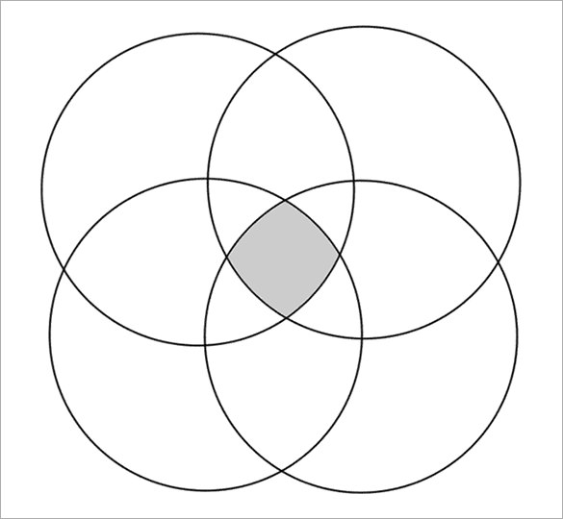
Play #8-a: Faster-Quote System Within Direct Division (Bright Spot)
CASE STATS:
.1% of customers;
33% of Direct Profits;
on 15% of Direct Bids
Involved:
.1% Vendors
On .25% of SKUs
Why not:
Do this 20% better?
?’s
.1% (10) Vendors;
⬅ 52.6% of Profits
.25% SKUs; 50% of profits ➔
P.S. Typical for:
Big profits from directs
and indirects; and,
Warehouse overall loses

Slide 18
Taking Core Quotes to Next Level
Interview best .1% customers (and vendors) to find new pain points
Temporarily remove all restraints for doing a “better job”
Invent and go.
Cases for customers’ estimators’
Fail safe, hot-wired, response-time drops by 80%.
They win more jobs on speed, and then you do too.
Case: industrial buyers who want fast quotes and summary report.
Additional “best practices” for the Quoting Division?

Slide 19
Play 8-b+: Quoting Best Practices?
Keep a quote log:
Poor time/profit yield customers? Products? Vendors? Creative fixes?
How to be more efficient and effective? (Exploiters? Auto/book or fees?)
Innovation metrics for:
Controllable inputs
Experiments in progress
Uncontrollable, output numbers (NBC/FTEE in quote department)
Rate everyone on:
Aptitude; attitude; mastery levels at cross-trained capabilities
Proactive recruiting and training of new talent!

Slide 20
Summary on Direct Quoting
Exploit GM%, cheat-high mindset of competitors.
Do: 1) smart experiments in 2) Bright Spots at 3) the extremes of the whale curves.
See quoting as a silo with input requests and output bids
Department P&L? Profit/FTEE? Higher Return on Invested Time (ROIT)
Assumptions:
Field research into most profitable and unprofitable customers➔insights.
Insights lead to smart-experiment learning and 5-20%+ improvements

Slide 21
Summary Thoughts
Credit-cost and fast-quoting are easier, quick payoffs.
Best “service value” for one (most net-profitable) niche at a time is tougher, but a sustainable profit-power-machine solution.
Intrapreneur/team to do: field research; define service metrics; achieve; market best service value; and, create some partnerships?
Best (guaranteed) Service Value is your Brand edge v Commodity lines
Best customer retention and partnering grows all rebates (“caboose”).
All – decisions and focus - improve with Net-Profit-Analytics
More plays in Webinar #6:

