Slide 1
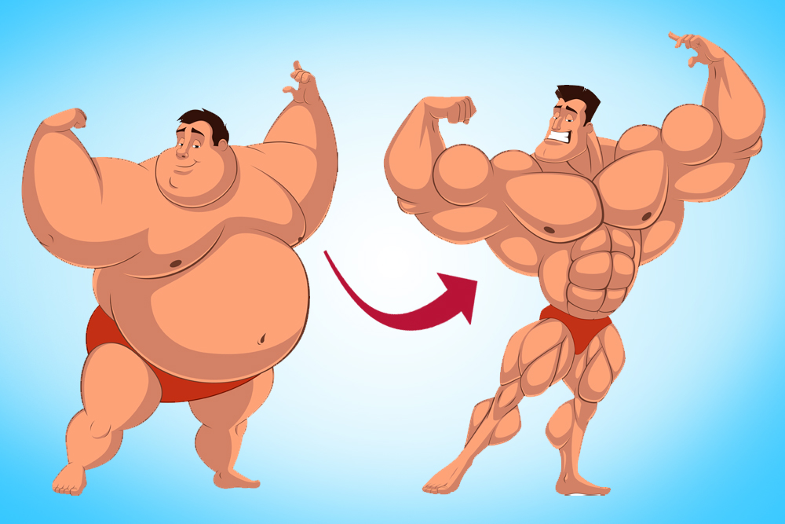
C-19 Paradigm Change: Getting to the “New Normal”
Chain-Saw; or, DURRR* Plans: A, B or C?
*Downsize, Upgrade, Refocus, Renew, Reinvent

Slide 2
My 11-Webinar Series* Completed 2/14/20
Then, World C-19 Shutdown hits US on Friday the 13th (March)
2nd Paradigm Shift which accelerates “eCommerce 2023”
In a coma requiring govt largess(debt) for Oxygen
Big Zombies win. Many small fry will close or consolidate
Recovery burdens? Fear, debt, unfunded Pensions, retirements, etc.
All (political spectrum) Re-open Economy Plans, not good:
Their Phase 2’s: require non-existent testing requirements
Average scenario? 80%-lite by fall. Back to peak in 2+ years
Plus: Global, supply-chains disrupted, re-shored, reknitted
Murphy’s Law on Steroids. Need 3 DURRR scenario plans?
* Under “ecommerce2023” tab at www.merrifieldact2.com

Slide 3
3 DURRR PLANS?
Dynamically adjustable – best, worst, likely – scenario plans
Currently unforecastable. Huge known unknowns. Unknown unknowns?
Wild cards like: autocratic, nationalistic leaders.
Hope isn’t a strategy. So: DURRR? (Ripped athlete within!)
Downsize Cost of Business. Fix hi-activity cost, low/no GM$ customers. Pick/order consolidation or defection ➔ Slack to layoff, reinvest
Upgrade: Keep Best Customers and People
Refocus, Renew: Improve total service value/partner
DURR ➔ profits, confidence and agility to (digitally) Reinvent.
The converging trends for eCommerce 2023 + C-19 accelerant

Slide 4
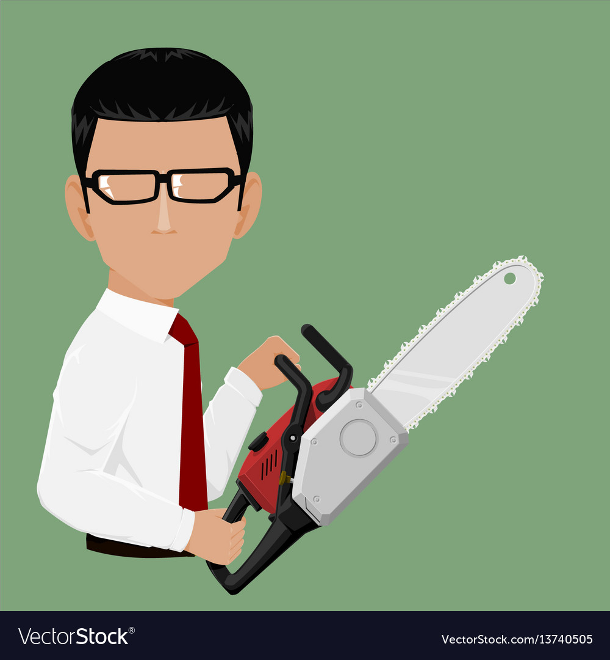
Chain-Saw Method v DURRR
Chain-saw? Uses financial #s lens. As margin dollars decline:
Cut all expenses proportionately
Cut all discretionary expenses
Cut all forward investments (2023 e-vision experiments)
Weaken capabilities across the board for best/worst customers
Sell harder in the same, old-school way
Be toughest on win-lose, juice-shifting with channel “partners”
v. Quid Pro Quo/Judo/Pivot into: win-win, sole-supply solution
Typical distributor has hiding within aggregate financial numbers:
60%+ losing: customers, orders and line/picks.
20% of customers➔ 150% profits to pay for losers and residual Op. Profit

Slide 5
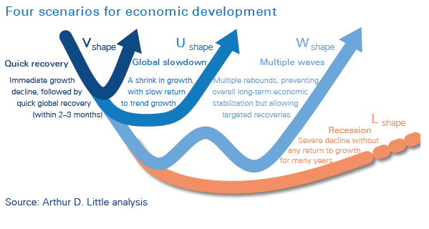
Why 3 Adjustable Plans (best, worst, likely) ?
But, No One Knows. Unforecastable. Stay Agile

Slide 6
Be Tri-Focal in All Decision Making
Bi-focal, Basketball analogy: decision-path against “full-court press”
Immediate lens: C-19 challenges. Heroic now! Tunneling mindset
Intermediate lens: Creatively doing DURR plans
Farsighted lens: (Reinvent) Back-cast to do E-win steps forward
Deal with Amazon Business (other category platforms?)
Beat laggard Brands and distributors with model innovations for:
Seamless, e-buying-journey: (omni) channel models
Customer-centric, 3PL replenishment process solutions (McD’s!)
Facetime/e-selling re-balance models

Slide 7
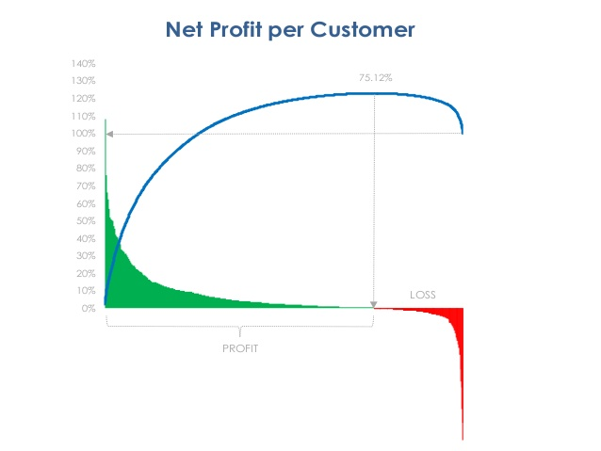
How Do You Do DURRR?
Long-answer: my 11-webinar series
Need Higher Math to Do Better Solutions
Calculus to engineer modern world and…
Net-Profit Analytics (at line/pick/sku level) to DURRR. Tiny steps or Leaps
Bias of 11 webinars is: “appreciative inquiry”; “bright-spot mgt”
Win at bright spots. Get too busy. Courage to fix losing customers.
Taking baby-steps towards a full-blown DURRR (which freaks Old Beliefs)
C-19 bias? Create slack to: lay-off > reinvest into re-focus, renew
Drastic, Plan-C case? Go after losers immediately.

Slide 8
Extreme DURR Case
Initial Facts:
Huge, small-customer, small-order problem
3000 accounts ➔ $7MM in sales. 40% ➔ 150% profits; 60% losers
120 accounts enough annual GM$s (3K+) to support 10+ rep-calls per year
Weak reps were assigned (calling on?) too many minnows
10 warehouse workers equal to their pay of 85% of average.
Vision: 5 industrial, cross-trained, athletes creating “Service Excellence”
Pay 140%+ of going warehouse wage for 200% output. Like: UPS, FedEx, LL Bean
Back-Office Paper-Mill for: billing, credits, A/R collection
Needs: Service Manager. Inside sales: split charm & technical

Slide 9
Extreme DURR Action Steps
Pix of 5 most net-profitable customers and 5 targets + “Big 8” (20/80…)
Reduced reps from 9 to 3 who got the 120, biggest accounts (3K+)
Created Telemarketing (1400) and Minnow (1500) Divisions
Minnows informed about new (profitable) terms. Telemarketing: 3-500 territory?
Tracked order consolidation. Laid off 3 in warehouse. 30% raises to rest.
Vision: 5 cross-trained, self-managing. 140%+ comp for 200% effective output
Redeployed 2 inside reps to: Service Manager; Tech database.
Laid off 2 back-office folks. (50 total to 42)
Loss to Profit in 2 months.
3 years later: $24MM sales; 1000 active accounts; 5% op profit

Slide 10
Plan C: Scary? Fast (small, hi-lev.) Steps (W #11*)
Create “Innovation Cost-Center”
Rent, Educate first “intrapreneur”
Attack highest, friction account with most progressive employee
Get wins. Promote “Value-Tales” to All.
Munch across the intersecting bell-shape curves of
Net-Profit DURRR plays and…
Most progressive, ambitious folks
Know that a huge percent of managers and reps may not change
* Shorthand notation for “webinar #11”

Slide 11
DURRR for Excess-Distributor, Metro Capacity
C-19, huge-demand drop in some channels. Slow recovery.
Case: Foodservice Distribution Channel
50% eat at home, 50% out ➔ 85/15
Soft re-boot; social distancing, new debt; less dining(?)
Too much capacity in big metro markets.
How to consolidate excess distribution capacity?
Buy only profitable customer relationships and then assets at fair value
Case: 4 of 10 distributors merged in Houston’s ‘85 bust
Blog 186 at www.merrifieldact2.com

Slide 12
C-19 Impact on “eCommerce 2023”
“eCommerce 2023” (W # 1,2).
Vision for B2B distribution channels in 33 months (from 4/20) Converging trends add to what vision?
Millennial B2B buyers taking over. Digital DIY first. Sense-making as needed.
5G bandwidth + engaging video content
B2B Brands’ omnichannel models
Amazon Business’ keeps innovating
4-5 story warehouses + Delivery Partners’ density/mile
Whole-goods (parts). Order 24/7 with 1-5 hour, trackable delivery
Digital workarounds to sell replenishment systems. Distributors do this better!
Regular facetime calls ➔ Multiple, Customer-centric, e-models
Turbo-charged by C-19 necessities and new habits!

Slide 13
C-19: New - Zoom and E-buying – Habits; and…
CEOs keep surveying customer CEOs about C-19’s
New needs and (even partial) solutions (for fees or goodwill points)
Rebalancing work from home v office.
And, rebalancing: e-sales and marketing mix.
Demands for concessions?
Quid Pro Quo v Win-Lose
Pivot into process tweaking or 3PL deals (unbundled services for fees)
Reps: ditto for all buying influences at key accounts
Get e-tool savvy now.
Fun, team to team experiments? Multi-strand rope building
Proactively, co-create v React to New Edicts eventually

Slide 14
Is this: “Weeks when Decades Happen” ?
“There are decades where nothing happens, and there are weeks when decades happen” Vladimir Lenin
Conform to channel ecosystem. But, forces of change build
Like tectonic plates until the earthquake
C-19 economic collapse + all-digital new habits for 12+ weeks
And, AMZ getting stronger due to unique: infrastructure, innovation speed.
Old business, selling models shaken down. Unweave, Reweave.
Cases: Milkmen ‘64-’68. Drug, Grocery selling in ‘80’s. etc. (W# 8,9)

Slide 15
Summary Thoughts
C-19: a crisis and a catalyst for faster ecommerce model changes
Do 3 Levels of DURRR Plans v. Chain-sawing to death
Need to master Net-Profit Analytics + insights, plays, skills, models
Lay-off to redeploy speed and ratio: context dependent
Be tri-focal to win in 2023 with constant updating of plans
Sign up your NPA Champion (intrapreneurs) for my 12-week course.
All 11 webinars will be recorded and available by mid-May
Ecommerce2023: http://www.waypointanalytics.net/waypoint.asp?pg=2150
At www.merrifieldact2.com: latest blogs; Core Renewal Roadmap.
Linkedin: “D. Bruce Merrifield, Jr”. Curated posts with commentary.

