Slide 1
Solve the Small-Order Problem!
Act Now & Return to High Profit Rates

Slide 2
The Small-Order Problem Grows
money-losing small orders have been a drain on profits for decades
massive escalation in manpower costs (up 68% since 2006) exacerbates the issue
recent increases in interest rates
new tools are needed

Slide 3
Profit Rates Down 31.8%

Slide 4
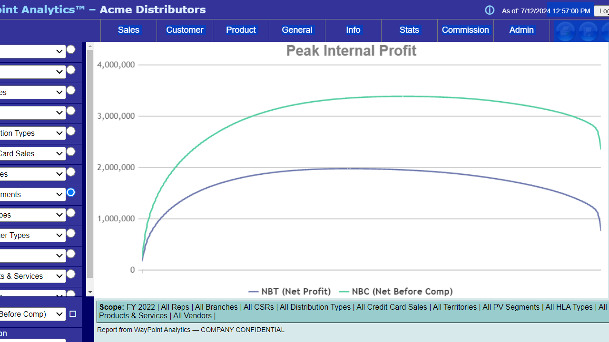
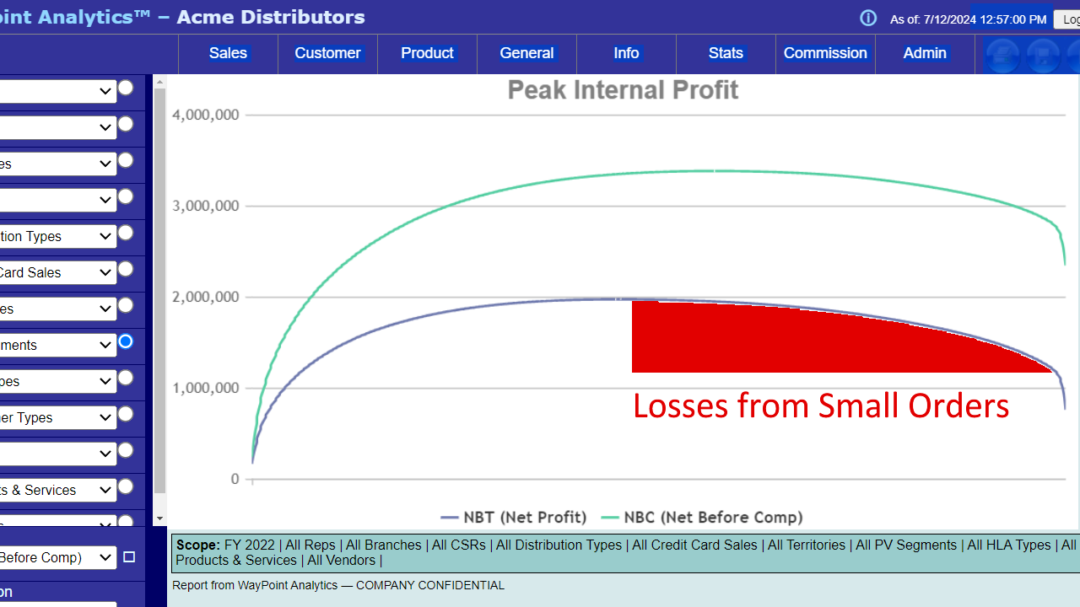
Depresses Profit
Reg-
-49%

Slide 5
Quantify Impact of Small Accounts
small order costs exceed order value
losses scale up

Slide 6
Need to Isolate & Examine Orders
most small orders come from small accounts
in WayPoint, these are the Reg- (small, money-losing) accounts
New PV Segments control isolates each segment on all reports

Slide 7
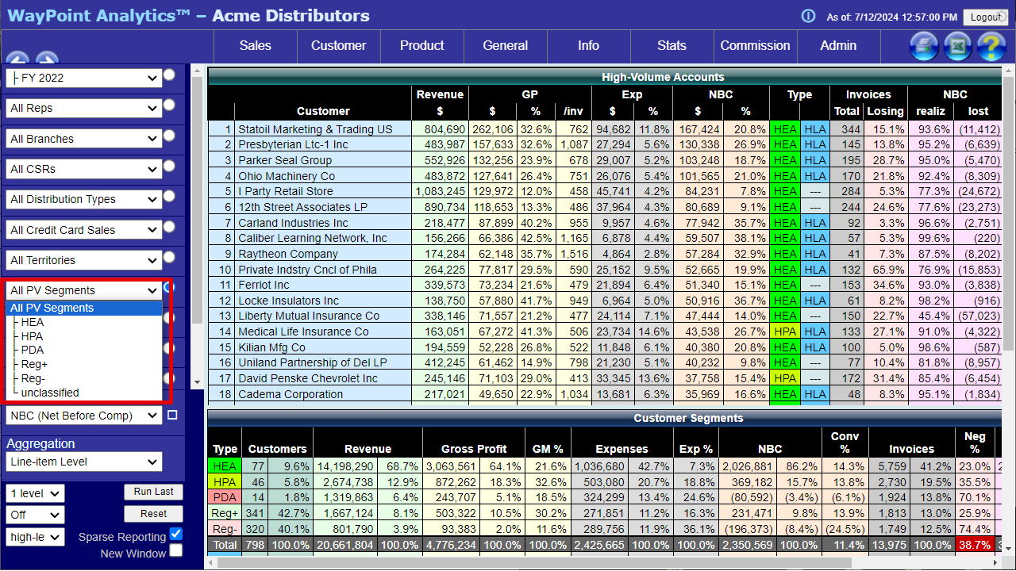

Slide 8
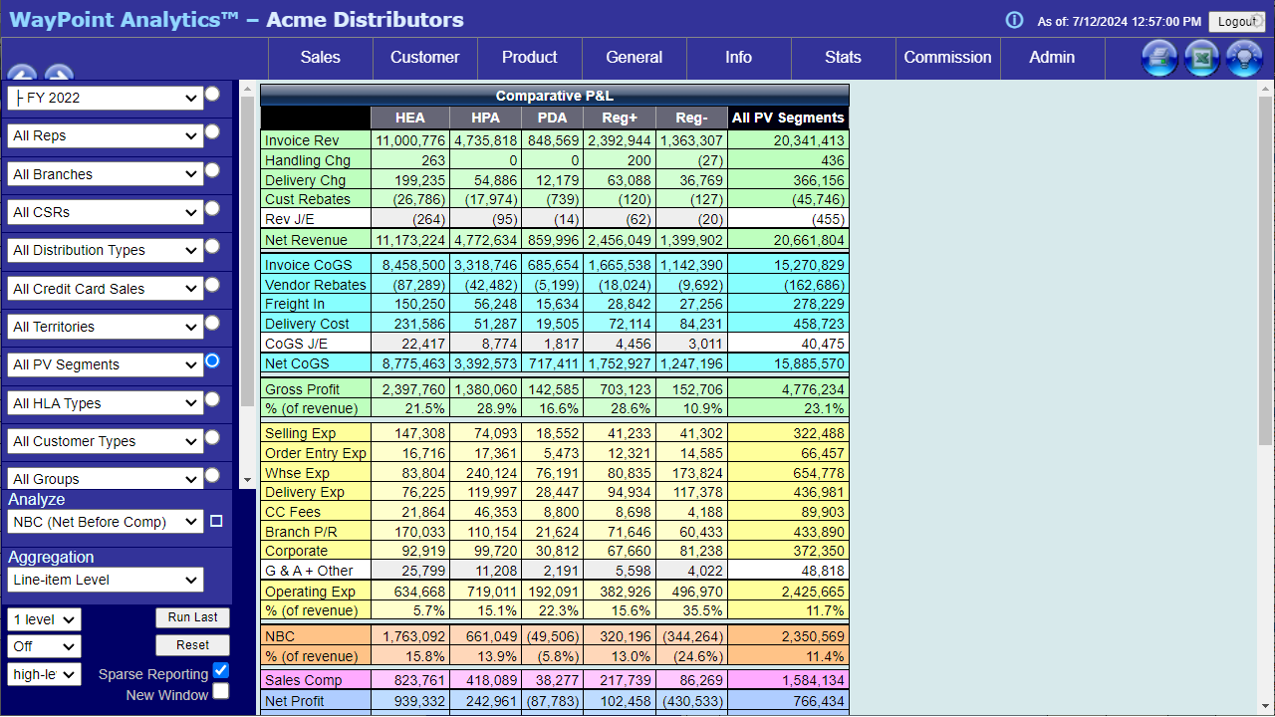

Slide 9
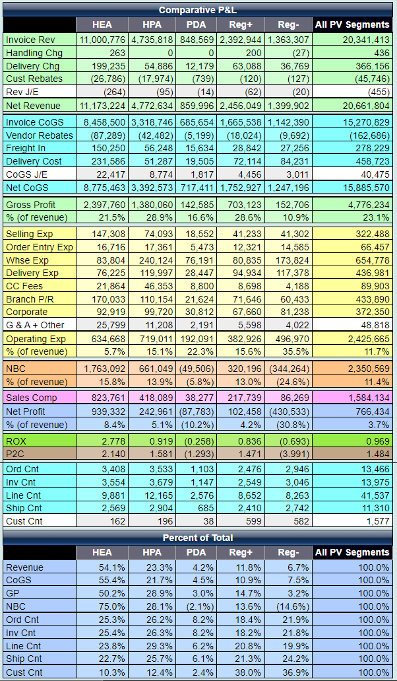

Slide 12
The Crux of the Issue
order value is insufficient to cover costs
need to see it in detail
NEW PV Segment control
NEW Customer | Logistics / Delivery report

Slide 13
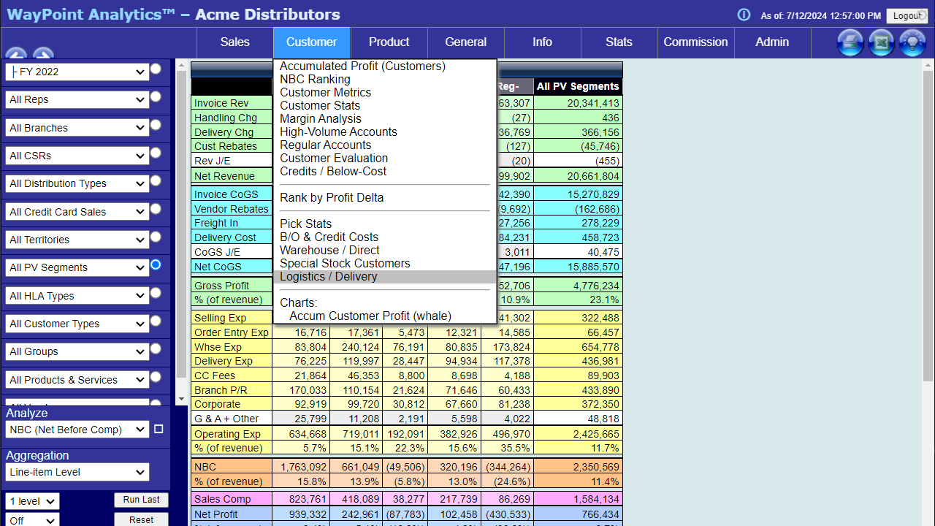

Slide 14
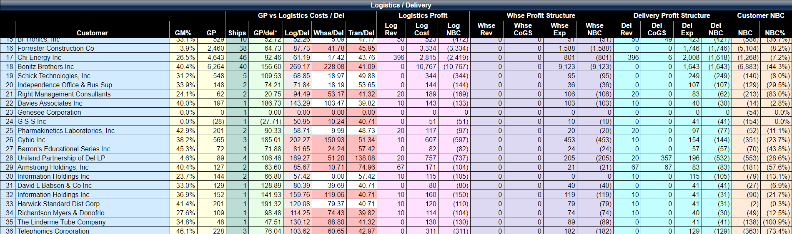

Slide 17
Quantify Impact of Small Accounts
money-losing small accounts drive small orders
small order costs exceed order value
may be as much as half of recent decline
average order value controlled by delivery count
losses scale up

Slide 18
What to Do
add margin to Reg- accounts
common raise is 10%
reduce delivery count:
use FREE delivery / delivery charges to influence behavior
set “delivery day” to consolidate orders
incentivize delivery charges

Slide 19
What to Do (cont’d)
reduce warehouse (manpower utilization) costs:
zone picking
pack station locations
conveyors
product organization
product selection:
multi-packs (MOQs)
don’t break cartons

Slide 20
What to Do (cont’d)
counter sales
eliminate costs: trade credit, commissions, delivery
self-service for high-frequency, low-value items
100% bar-coded product

Slide 21
Get Your Reg- Account List
select Reg- from the PV Segment control
choose Customer | NBC Ranking report
export to Excel
report will list customer codes

Slide 22
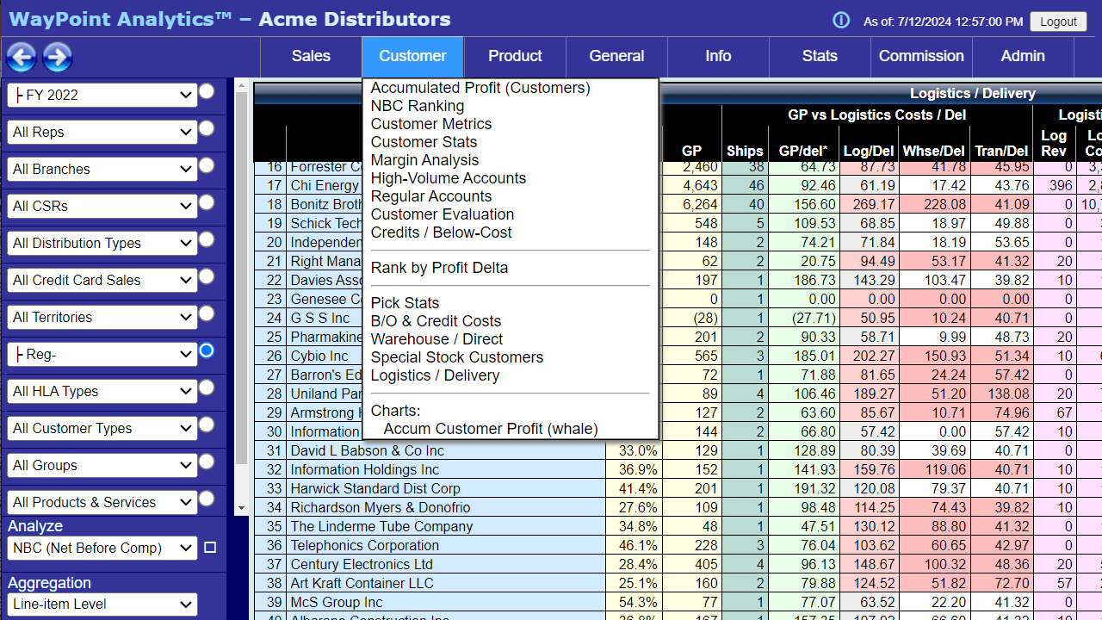

Slide 23
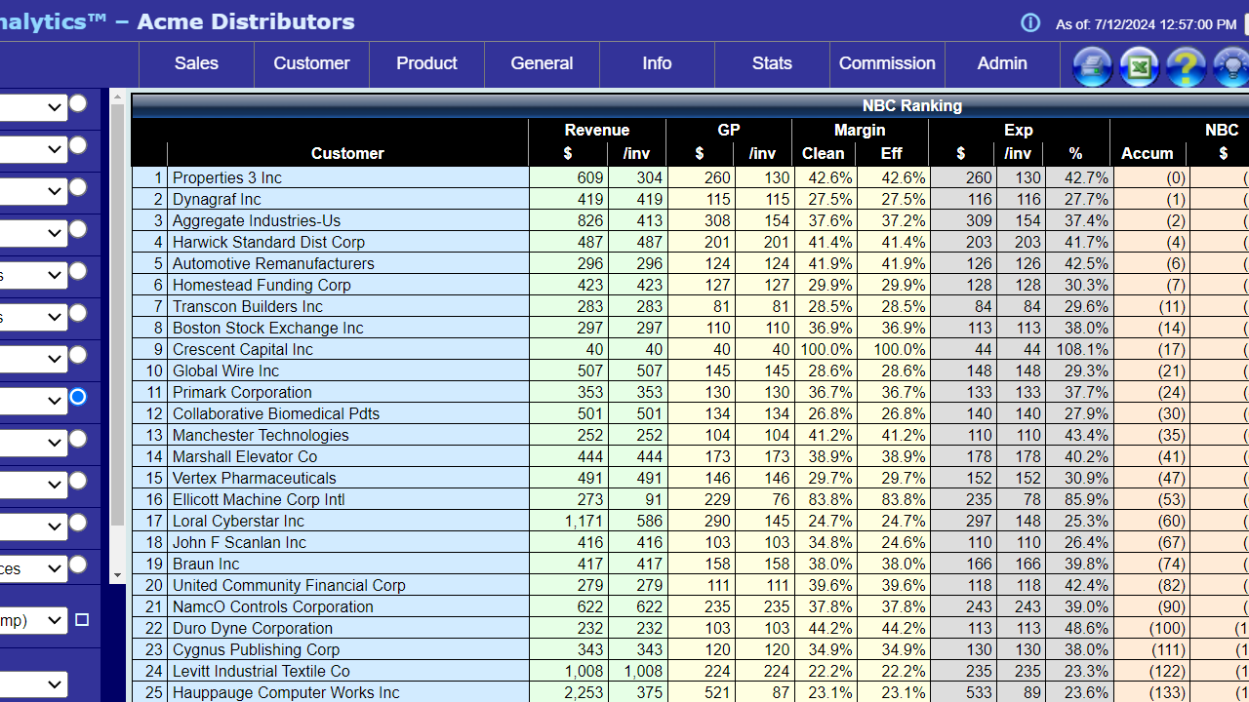

Slide 24
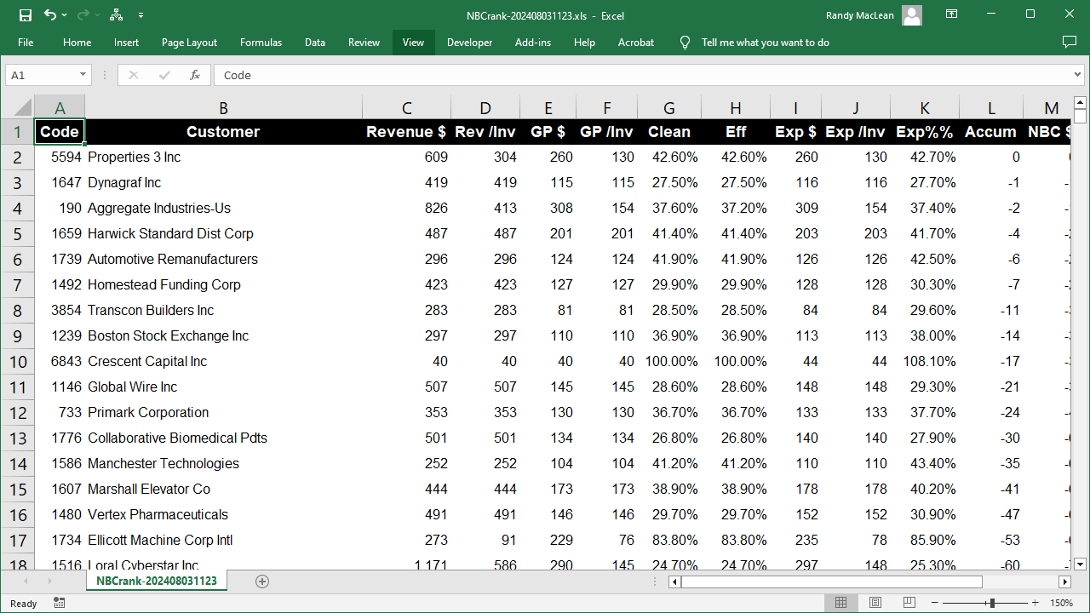

Slide 25
Recovering Lost Profits
recent escalation of manpower and interest costs has significantly cut into profits
imbalance between order value and order logistics is the source of the problem
identify the accounts driving the bulk of the problem and:
increase margin
reduce and/or monetize deliveries

Slide 26
Reg- (money-losing small accounts group)
1/3 of active accounts
produce only 3.2% of total order value
more than 20% of expenses

Slide 27
Small Order Losses
are consuming profits traditionally delivered to the bottom line
require a focused solution
need new tools:
PV Segmentation selection
analysis showing cause of losses, prevalence of problem

Slide 28

Call us – we can help!
www.WayPointAnalytics.net
info@waypointanalytics.com
480-426-9955

